Slide 1
Pitreavie AAC Endurance
Find your own PAACE
Ready Steady Go Pitreavie!

Slide 2
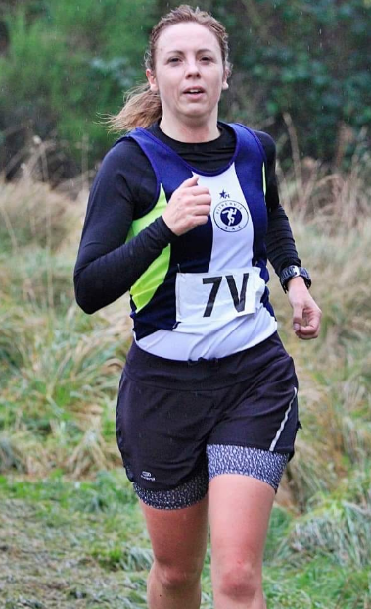
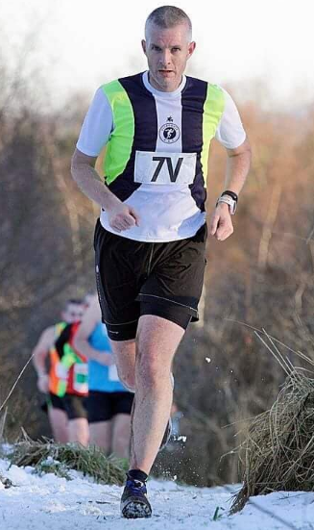
Introduction
Nicola Moriarty
PAAC Running Coach/RSGP Jog Leader
Campbell Blair
PAACE Team Manager/Jog Leader

Slide 3
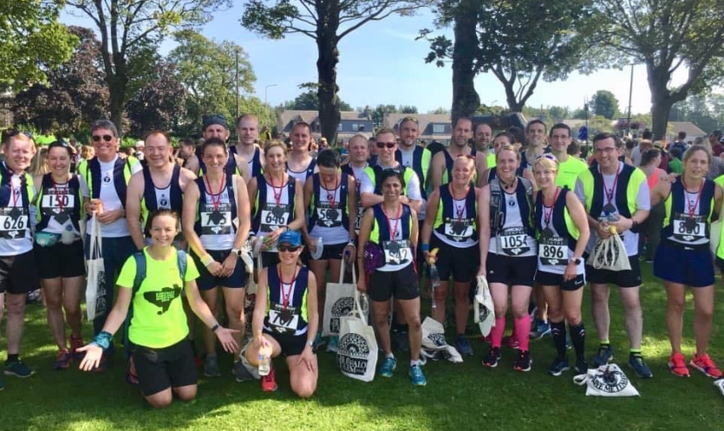
Background: PRR - A group in decline
Long established club, but focus on T&F; limited engagement with Road Runners.
Losing members and struggling to attract new runners; 60 members down to 30.
Low training attendance, with runners isolated on long runs.
Lack of training plan or structure.
Limited promotion or member engagement.
Increased competition in the local area; 2 main running clubs (Carnegie and PH) and 2 jogscotland groups (JS Dunfermline and RSGP)
Group at a crossroads – do we carry on?

Slide 4
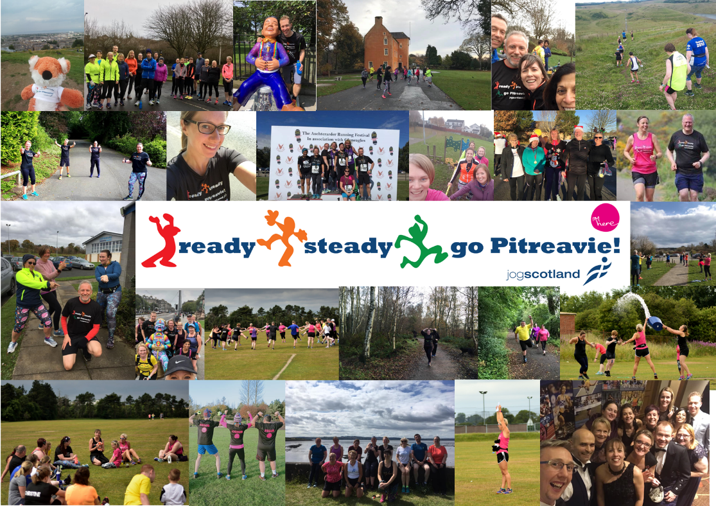
Background: RSGP – From small acorns
Founded in Spring 2016
Two newly qualified jogleaders
Vision to be friendly and inclusive
Kick-start the pathway from beginner to club runner, and break down the barriers in between
C2K program (READY) with transition to STEADIES
Focus on promoting good mental health
But…members not transitioning to PRR as hoped; risk that another sizeable club was being created.
#gettingfifefitonejoggeratatime

Slide 5
Time for a plan…integrate to grow
Integration of PAACE and RSGP
A new vision & objectives
The PAACE pathway
A Training plan designed for all
New routes/sessions to keep group together
We asked members for ideas & feedback
Rebrand – time for a new name…
… Pitreavie AAC Endurance was formed!

Slide 6
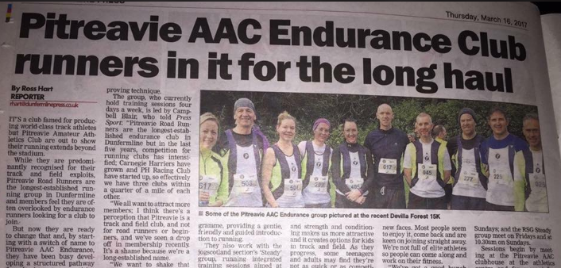
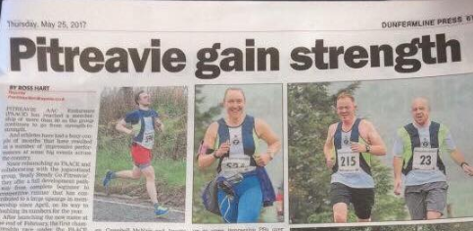
Promote, Engage, Deliver…and repeat
Relaunch – time to promote
Enhanced social media presence
Enquiries prioritised
New Training plan well received
We proved sessions could be inclusive
A new events format to encourage participation
#TeamPAACE – a new identity and culture
Continued promotion as we grew

Slide 7
So far, so good!
210
PRR – PAACE Members
KOR
(50)
PAACE Club Champs Participation
167
141
146
Performances
2016
35
Runners
PAACE launched
March 2017
2017
212
55
New Club Champ format
90
63
2018
356
97
40
29
2019
434
100
Mar 15
Mar 16
Mar 17
Mar 18
Mar 19
Mar 20
Mar 21
Promoting participation in events & generating more prize winners

Slide 8
PAACE Takeaways
Have a plan and some structure
Be visible
#TeamPAACE: Create an identity and team culture
Be inclusive
Keep the group together (where possible)
Don’t be too technical
Keep members engaged and ask for feedback
Recognise all achievements
Encourage socialising outside of training nights
Get people involved
Have fun! Running and being part of a club should be enjoyable

Slide 9
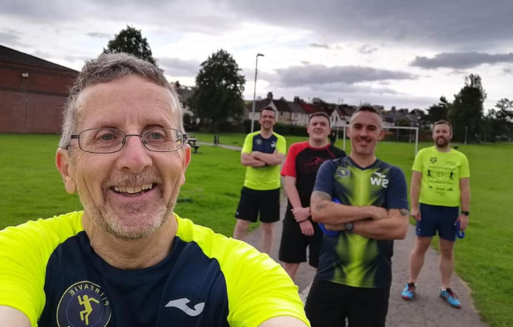
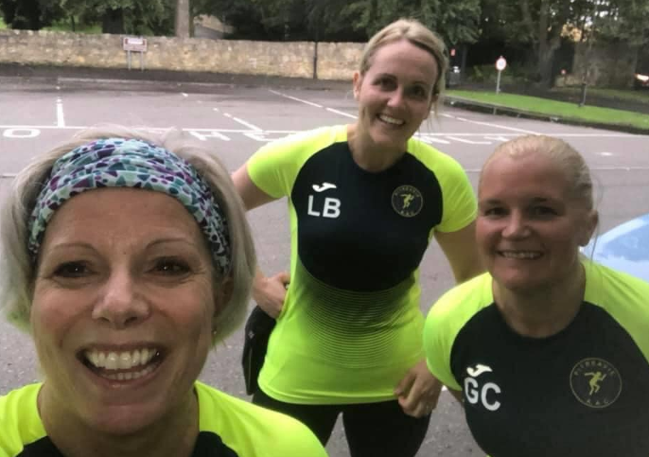
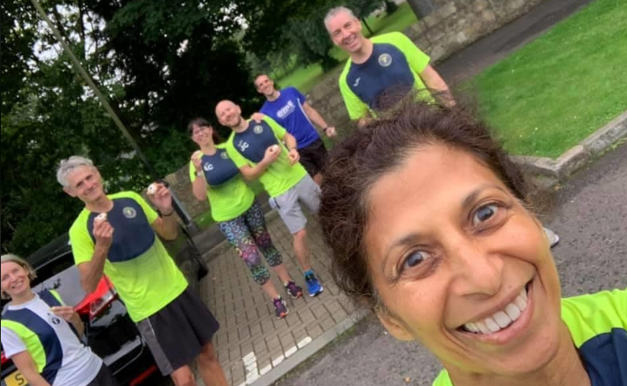
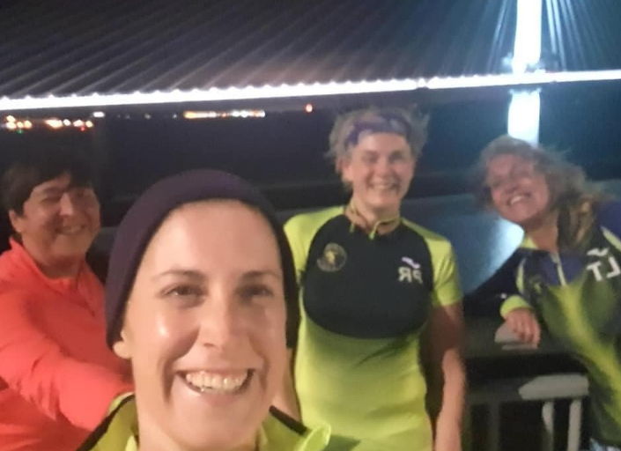
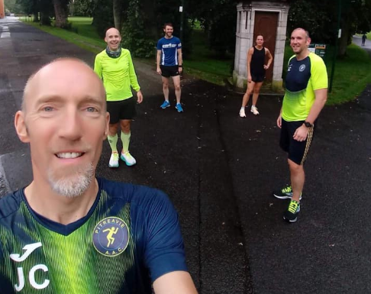
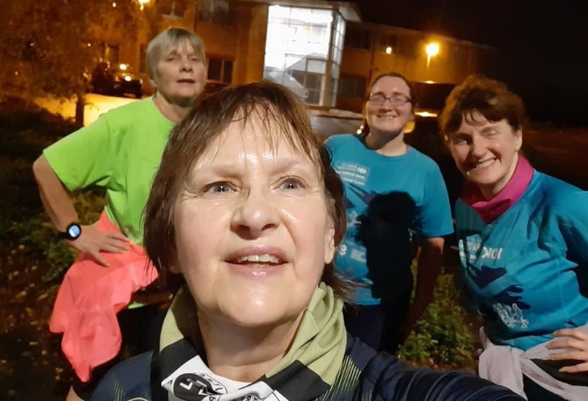
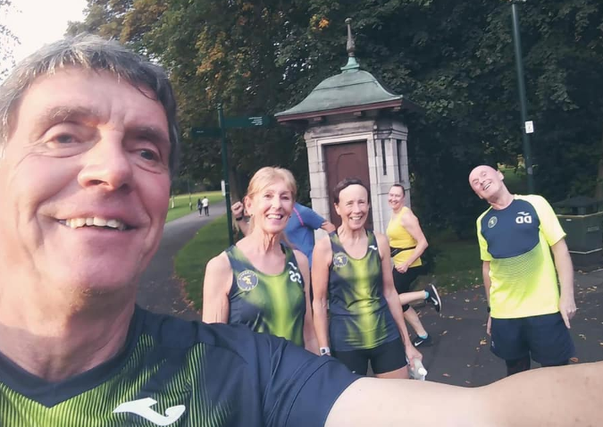
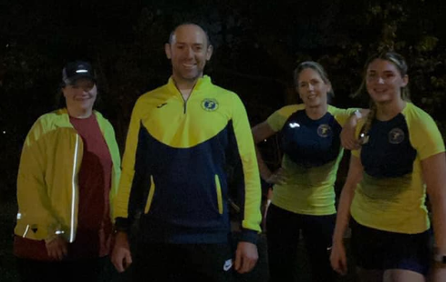
The End…or the beginning of the next chapter!
Thanks for listening!

Slide 10
PAACE: A new name and a new vision
“As an integral part of Pitreavie AAC we will help runners of all abilities to achieve their personal running goals in a friendly and supportive environment”
INCLUSIVE: We will be welcoming to all and ensure all abilities are catered for
STRUCTURED: Training will be designed around set objectives/goals; train together, develop together
COMPETITIVE: We will encourage participation in events and promote healthy competition
ENJOYABLE: We will foster a ‘Team PAACE’ spirit through running and socialising
SUPPORTIVE: We will create a supportive environment with a focus on Health & Mental Wellbeing
Back to 'Time for a Plan'

Slide 11
The PAACE pathway…a program for all
Overarching
Running Club
Pitreavie AAC Endurance
RSGP
PAACE
Ready
Steady
Go
Sub-Groups
Couch
to 5k
5k to 10k
10k + + +
Training
Programs
Bespoke C25K Program
Transition Program
PAACE Training Plan
Parkrun Series
Covid Time Trial Series
Events &
Competition
Speed/Short Race Series
5 mile handicap series
XC Series
Endurance Series
Back to 'Time for a Plan

